Slide 1

Object Oriented Programming
Structural Design Patterns: Decorator
IT620
Sourish Dasgupta
Assistant Professor, DA-IICT, Gandhinagar
https://daiict.ac.in/faculty/sourish-dasgupta

Slide 2
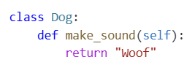

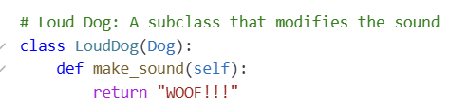


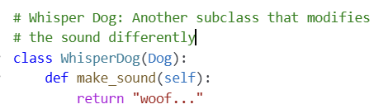
Why should we think about Decorators?
???
IT560: Structural Design Patterns: Decorator
Sourish Dasgupta

Slide 3
What’s wrong with class inheritance?
Class Explosion: New subclass for each new behavior (e.g., loud, whisper, echo, etc.)
Combo behavior?? → Exponential growth!
Lack of Flexibility: Want to add a new behavior? Or modify an existing one? Change the class hierarchy
No way to mix and match behaviors at runtime without creating additional subclasses
Maintenance Challenges: A new subclass? → additional maintenance overhead
Base class Dog got changed? → Update all the subclasses to maintain consistency
IT560: Structural Design Patterns: Decorator
Sourish Dasgupta

Slide 4
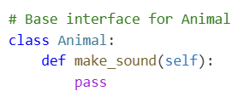
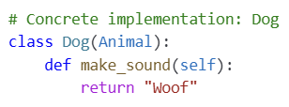
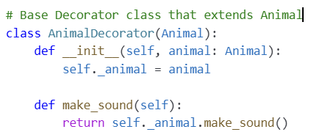
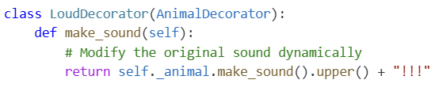
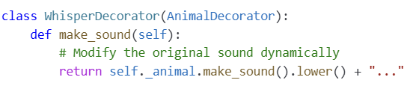
How does Decorator help? Modifying and extending on-the-fly
IT560: Structural Design Patterns: Decorator
Sourish Dasgupta

Slide 5
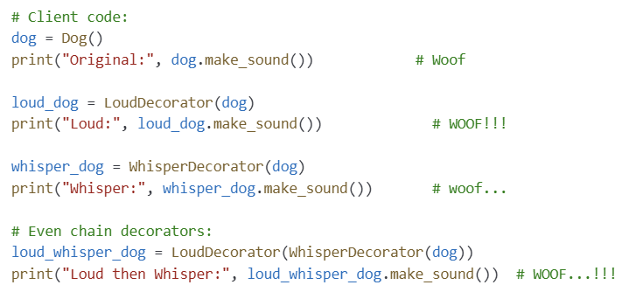
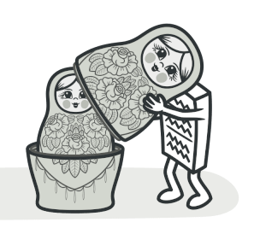
How does Decorator help? Modifying and extending on-the-fly
IT560: Structural Design Patterns: Decorator
Sourish Dasgupta

Slide 6
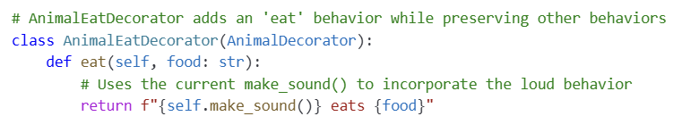
How does Decorator help? Adding new behavior (eat) on-the-fly
No eating behavior yet
Needs to be compatible!
IT560: Structural Design Patterns: Decorator
Sourish Dasgupta

Slide 7
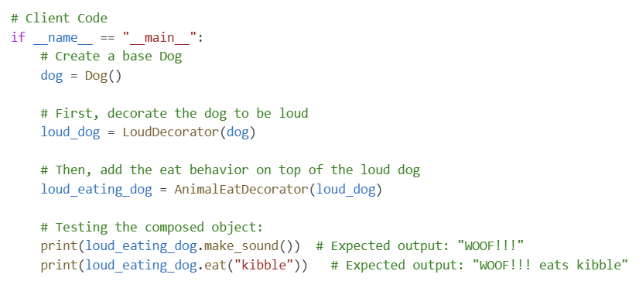
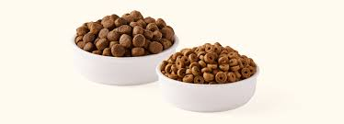
How does Decorator help? Adding new behavior (eat) on-the-fly
Why does this work??
IT560: Structural Design Patterns: Decorator
Sourish Dasgupta

Slide 8
Key takeaways
Aspect | Description
Purpose | Dynamically add new behavior to objects without altering their structure.
Key Benefit | Adheres to the open/closed principle (SOLID); enhances flexibility and reusability.
Implementation | Involves creating a base decorator class and one or more concrete decorators.
Usage | When you need to extend the functionality of objects in a flexible and combinable way.
Comparison to Subclassing | More scalable and flexible than creating a separate subclass for each behavior combination.
IT560: Structural Design Patterns: Decorator
Sourish Dasgupta

Slide 9
How does the Decorator differ from the others?
Aspect | Decorator | Adapter/ Facade
Primary Purpose | Dynamically extend or modify an object's behavior → wraps with additional functionality | Adapter converts an incompatible interface, while Facade simplifies interaction with complex subsystems.
Behavior Extension | Can add, remove, or combine behaviors at runtime without altering the original object's code | Typically static transformations or simplifications → no runtime modification of behavior
Flexibility | Enables stacking of multiple decorators for flexible composition of responsibilities | No dynamic behavior extension.
Transparency to Client | The client interacts with the decorated object using the same interface, unaware of the added behaviors | The client interacts with the adapted/facaded interface, but the primary goal is interface consistency or simplification
IT560: Structural Design Patterns: Decorator
Sourish Dasgupta

Slide 10
Does Decorator ring a bell with FP?
Aspect | Decorator Pattern | Functional Programming
Extending Functionality | Wraps objects to dynamically add or modify behavior without changing the original class. | Uses higher-order functions to create new functions by composing existing ones.
Composability | Decorators can be stacked or chained to combine multiple behaviors at runtime. | Functions can be composed together (e.g., using composition operators) to build complex operations.
Flexibility | Enables runtime modification and flexible extension of an object's capabilities. | Encourages building programs by composing small, reusable functions in different combinations.
IT560: Structural Design Patterns: Decorator
Sourish Dasgupta

Slide 11
Wait, but isn’t this the subway making problem? (Builder)
Aspect | Builder Pattern | Decorator Pattern
Primary Purpose | Focuses on constructing complex objects step by step, separating construction from representation. | Focuses on dynamically adding responsibilities or modifying the behavior of an object at runtime.
Composition Type | Composes various parts or components during object creation to form a new complex object. | Wraps an existing object to extend or alter its behavior without changing its interface.
Timing | The object is built once, with the final configuration being set at creation time. | The object’s behavior can be modified or extended after creation, even at runtime.
Use Case Example | Building a complex configuration (like a house, or a complex document) where various parts need to be assembled in a specific order. | Adding extra functionalities (like logging, caching, or permission checks) to an object without modifying its existing code.
IT560: Structural Design Patterns: Decorator
Sourish Dasgupta

Slide 12
Can we make the decorators completely decoupled?
Needs to be compatible!
Why should Eat decorator have to be aware of MakeSound decorator?
IT560: Structural Design Patterns: Decorator
Sourish Dasgupta

Slide 13
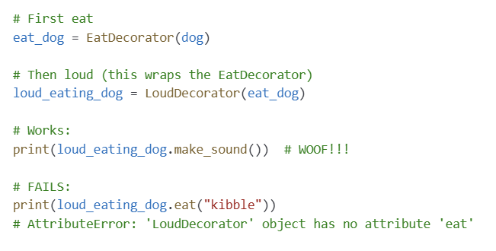
Why is decoupling needed? Reverse chaining may not work!
IT560: Structural Design Patterns: Decorator
Sourish Dasgupta

Slide 14
Can we do better?
IT560: Structural Design Patterns: Decorator
Sourish Dasgupta

Slide 15
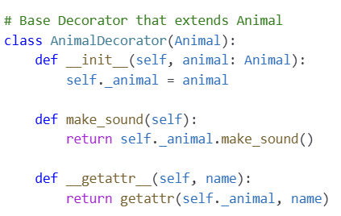
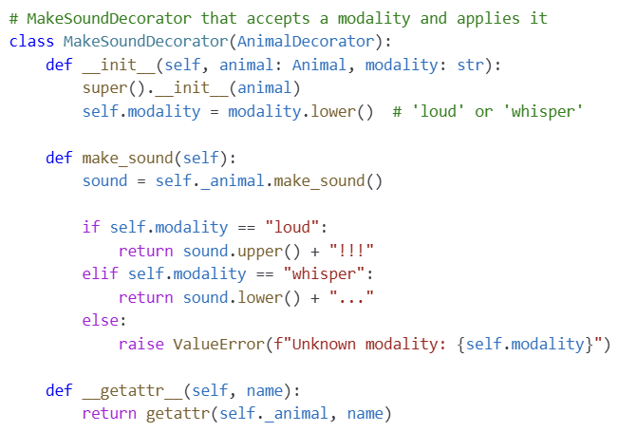
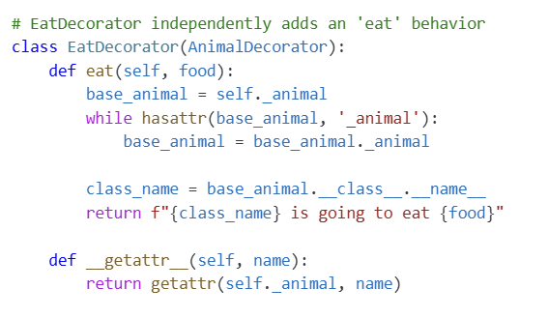
How to make the chaining work in any order?
IT560: Structural Design Patterns: Decorator
Sourish Dasgupta

Slide 16
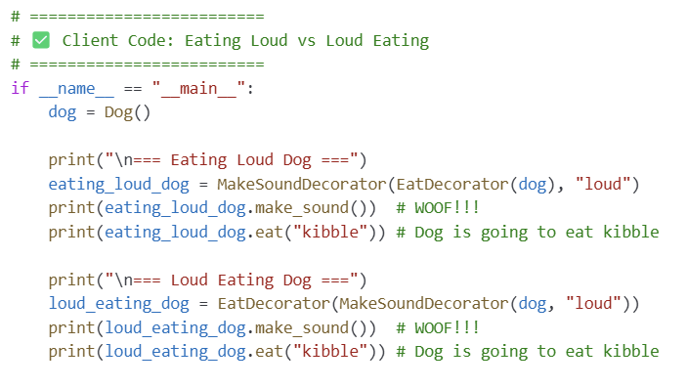
Now any order works!
IT560: Structural Design Patterns: Decorator
Sourish Dasgupta

Slide 17
Haven’t we seen decorators before?
Remember the @-styled functions?
IT560: Structural Design Patterns: Decorator
Sourish Dasgupta

Slide 18
Decorator Design Pattern vs. Decorator Feature
Decorator | Purpose
@property | Define a method as a read-only property
@staticmethod | Define a static method (no self)
@classmethod | Define a method that operates on the class
@functools.lru_cache | Cache results of expensive computations
@functools.wraps | Preserve function metadata in decorators
@abc.abstractmethod | Define abstract methods in base classes
@dataclasses.dataclass | Automatically generate data class boilerplate
@contextlib.contextmanager | Simplify creating context managers
IT560: Structural Design Patterns: Decorator
Sourish Dasgupta

Slide 19
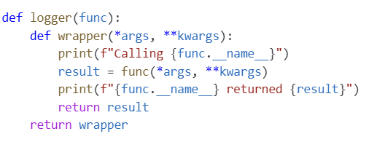


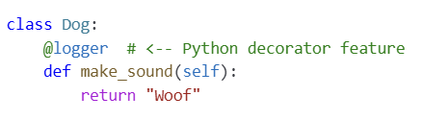

Decorator Design Pattern vs. Decorator Feature
vs.
IT560: Structural Design Patterns: Decorator
Sourish Dasgupta

Slide 20
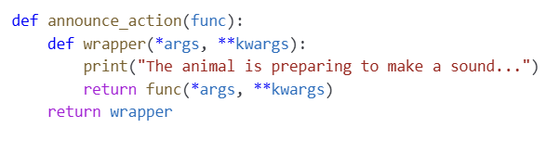

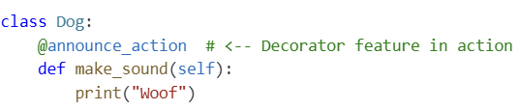
Decorator Design Pattern vs. Decorator Feature
vs.
IT560: Structural Design Patterns: Decorator
Sourish Dasgupta

Slide 21
To summarize
 | Decorator Pattern | Decorator Feature (@)
What | Structural design pattern | Python syntax + language feature
Purpose | Add behavior to objects | Add behavior to functions/classes
Method | Class-based, runtime wrapping | Function/class wrapper, definition-time
Examples | GUI widgets, streams | @property, @staticmethod, @lru_cache
IT560: Structural Design Patterns: Decorator
Sourish Dasgupta

Slide 22
Can we use Decorator feature for Decorator pattern?
IT560: Structural Design Patterns: Decorator
Sourish Dasgupta

Slide 23
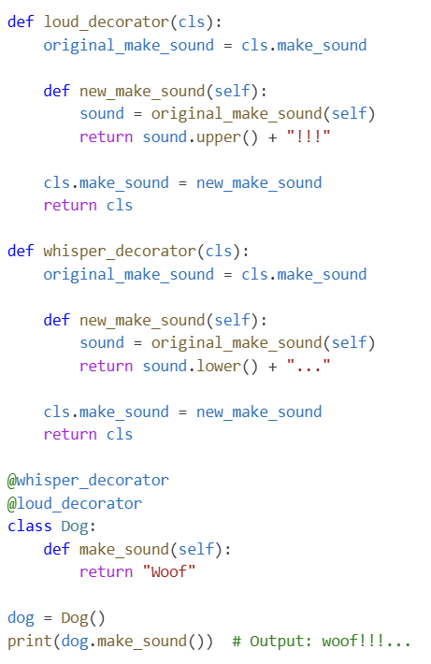
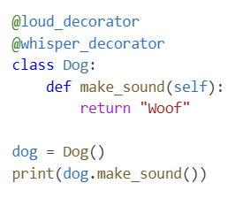
Using Decorator feature for Decorator Pattern
???
IT560: Structural Design Patterns: Decorator
Sourish Dasgupta

Slide 24
Will decorating always look good?
IT560: Structural Design Patterns: Facade
Sourish Dasgupta

Slide 25
Cautionary comments for Decorator pattern
When | Why It’s Bad
Too many decorator layers | Hard to trace, maintain, and debug (Decorator Hell)
Inheritance is clearer/simpler | Simpler than wrapping objects unnecessarily
Performance is critical | Decorator overhead adds indirection and latency
Behavior order is tricky or unclear | Hard to understand the interaction of behaviors
Mutually exclusive behaviors exist | Allows illogical combinations without constraint
IT560: Structural Design Patterns: Decorator
Sourish Dasgupta

Slide 26
Cautionary comments for Decorator as a Python feature
When | Why
Code becomes hard to read or trace | Wrapping hides behavior
You need per-instance behavior | Decorators are static at definition time
Debugging gets complicated | Decorators can obscure function identity
Performance is critical | Decorators add overhead
Behavior needs dynamic control | Decorators are static unless configured
Simple logic doesn't justify extra complexity | Decorators can be overkill
IT560: Structural Design Patterns: Decorator
Sourish Dasgupta

